Slide 1
CLASSROOM RULES
Be on time
Be interactive
100% or Nothing
Do all Daily Challenges

Slide 2
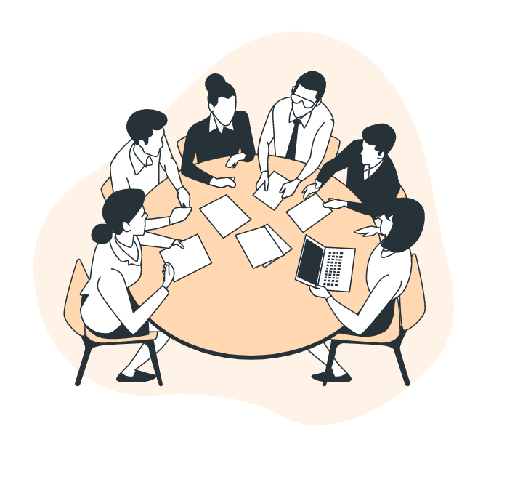
Lesson 8:
PRONOUNS
Brought to you by LangGo

Slide 3
REVIEW

Slide 4
GRAMMAR + VOCABULARY

Slide 5
SHADOWING
He’s in his thirties, I guess. About 35.
He’s really not very tall, about 175 centimeters.
It’s not really long but it’s very straight.
What does your girlfriend look like?
He’s not very tall—about average. But he’s really good-looking.
What color is his hair?/ What color hair does he have?
She’s got glasses and short curly hair.

Slide 6
SPEAKING
1. What does your father look like?
2. What does your mother look like?
3. What does your brother/ sister look like?
4. What kinds of clothes does he/she often wear? (gộp vào 3 câu trên, miêu tả ngoại hình + các loại quần áo thường mặc luôn)

Slide 7
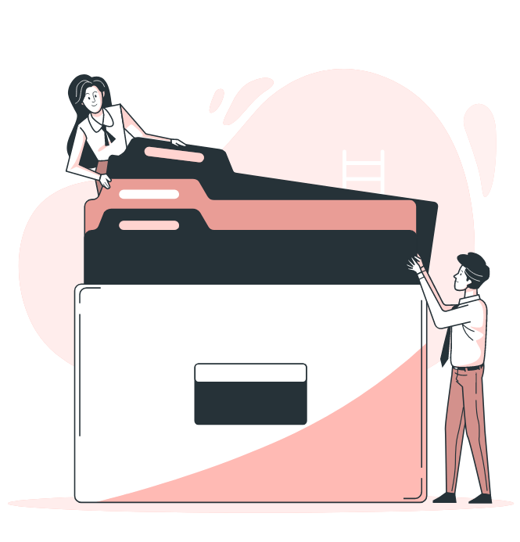
Objectives
01
02
03
04
Personal pronouns
Reflexive pronouns
Demonstrative pronouns
Interrogative pronouns

Slide 8
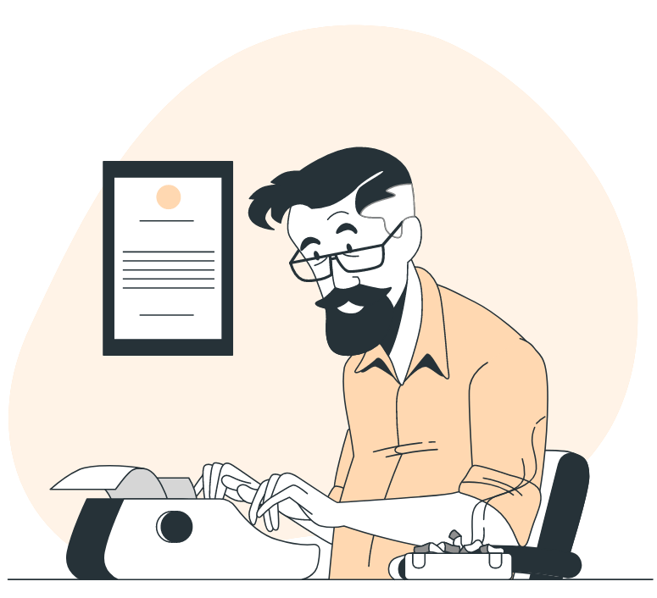
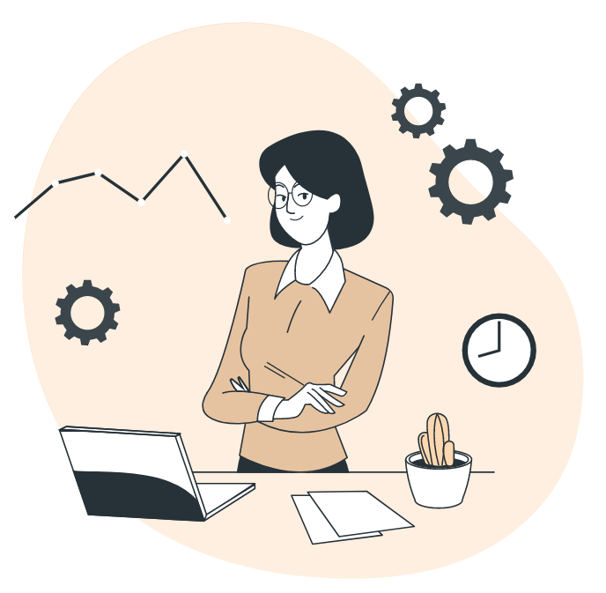
What is a pronoun?
This is my father. He is a teacher.
Jenny is kind. Everybody likes her.
Đại từ dùng để thay thế cho danh từ chung/ riêng.

Slide 9
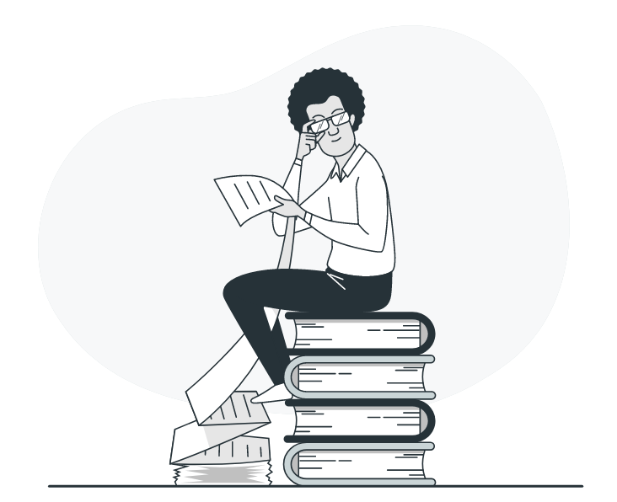
Pronouns
Subject pronouns
Personal pronouns
Object pronouns
Reflexive pronouns
Demonstrative pronouns
Interrogative pronouns

Slide 10
Which words have been replaced by new words?
She is an excellent teacher.
Mary is an excellent teacher.
The computer is expensive.
It is expensive.
The apples are very good.
They are very good.
Peter and Jane are students.
They are students.
“I”, “you”, “he”, “she”, “it”, “we”, “they” được gọi là subject pronouns, đóng vai trò là chủ ngữ trong câu.

Slide 11
Which words have been replaced by new words?
I bought a book yesterday.
I bought it yesterday.
Mary gave Peter a present.
Mary gave him a present.
The parents drove the children to school.
The parents drove them to school.
Tim picked up the soccer balls.
Tim picked them up.
“me”, " you”, “him”, “her”, “it”, “us”, “them” được gọi là object pronouns, đóng vai trò là tân ngữ (nhận hành động) trong câu.

Slide 12
 | Subject pronouns | Object pronouns
First person singular | I | Me
Second person singular | You | You
Third person singular | He / She / It | Him / Her / It
First person plural | We | Us
Second person plural | You | You
Third person plural | They | Them

Slide 13
Practice!
My sister loves fashion. ______ often wears colorful dresses.
I am trying on my new clothes, but these jeans are too big for ______. . I don’t like__________.
That jacket looks great on you. Where did ______ buy it?
Tom is wearing a new hat. I like ______ a lot..
My friends and I went shopping, and______ bought some stylish shirts.
Look at those beautiful scarves! Where did you buy_________?
Anna has curly hair. ______ always ties it back when she works.
James and Sara look happy because ______ found a perfect outfit.
Have you seen ______? She looks so different - she’s just had a new haircut!
She
me
them
you
it
we
them
She
they
her

Slide 14
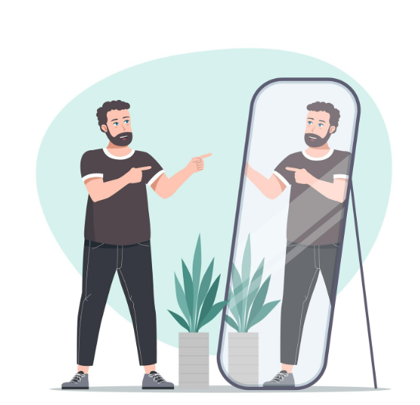
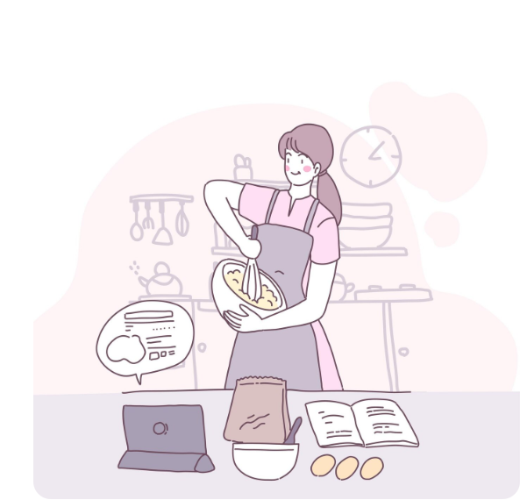
Reflexive pronouns
He saw himself in the mirror.
I bake the cake myself.
Khi chủ ngữ và tân ngữ là cùng 1 người.
“Tự” làm gì đó, không có ai giúp đỡ

Slide 15
English pronouns | Subject pronouns | Object pronouns | Reflexive pronouns
1st person | I | me | myself
2nd person | you | you | yourself
3rd person (male) | he | him | himself
3rd person (female) | she | her | herself
3rd thing | it | it | itself
1st person (plural) | we | us | ourselves
2nd person (plural) | you | you | yourselves
3rd person and thing (plural | they | them | themselves

Slide 16



Demonstrative pronouns
SINGULAR
Dùng this và these để chỉ những vật ở GẦN.
Dùng that và those để chỉ những vật ở XA.
This is an apple.
That is an apple.
PLURAL
These are apples.
Those are apples.

Slide 17
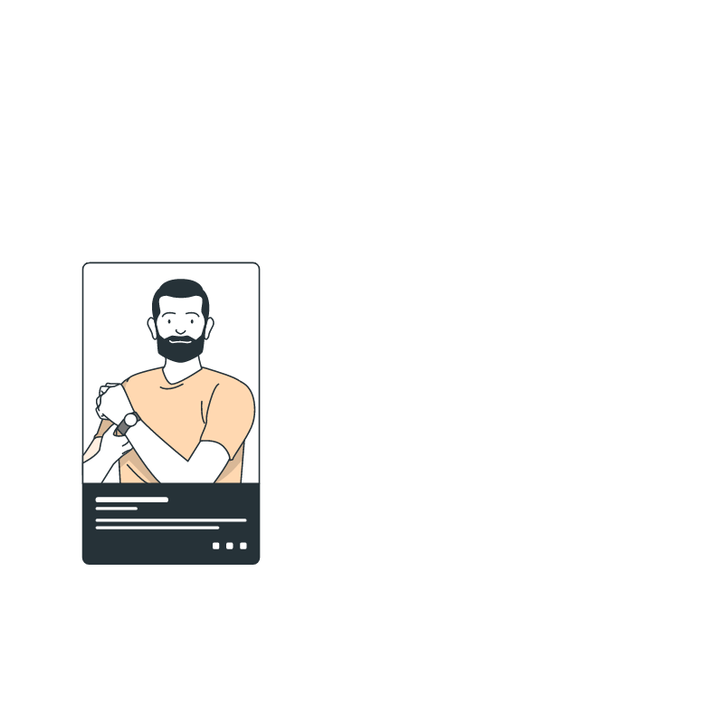
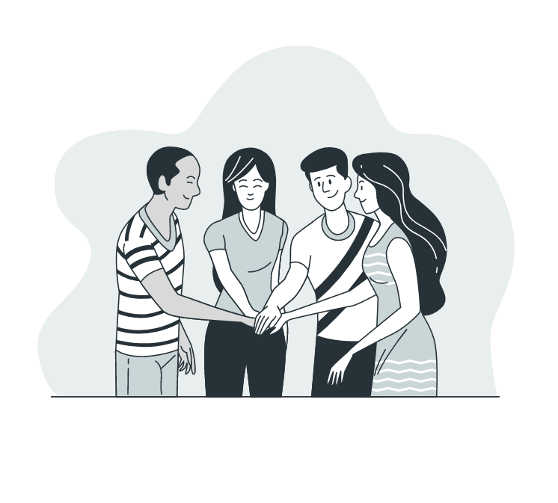

Interrogative pronouns
Who is he?
Whom are you playing with?
Which do you prefer?
Whose is this umbrella?
What are you doing?
who, whom, whose, what, which là những đại từ dùng để hỏi

Slide 18
Fill in the gap with the suitable pronouns (personal, reflexive, demonstrative):
Yesterday, my friend and I went shopping because ______ wanted to buy some new clothes. Anna found a beautiful blue dress, and she bought ______ for the party. Tom looked at ______________ in the mirror and decided that ______ needed a new jacket too. I tried on several shirts, but I didn’t like any of__________. Finally, I chose a red sweater because ______was warm and comfortable. Suddenly, Anna pointed at the shoe rack. “Look at _________ shoes over there! Aren’t they stylish? ________ said, “I can buy _________ for my sister.” We all enjoyed _____________ and promised to come back to the store again.
we
it
himself
he
them
it
those
she
them
ourselves

Slide 19


Thanks!
See you later!

